Slide 1
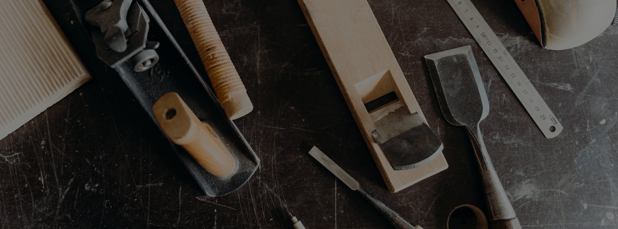
CUSTOM FURNITURE WORKSHOP
A One Person Shop, Built to My Own Standard
Business plan and savings roadmap, target opening 2030
Prepared by Jordan Thomas McDaniel, Raleigh NC

Slide 2
THE PLAN
Vision and Objectives
• A solo custom furniture shop, not a contracting crew
• Commissions for tables, cabinets, and built ins
• Quality over volume, built to a single standard
• Funded by savings, no loans, stay out of debt
• Grow from the band network and word of mouth
• Open around 2030 after journeyman experience
Why now
Finish carpentry pays the bills and builds the hands. The shop is the long goal, earned one tool and one saved dollar at a time. The apprenticeship wraps in 2027, then two to three years of experience and saving before the doors open. This deck lays out the numbers so the goal stays honest.
Workshop business plan
Confidential

Slide 3
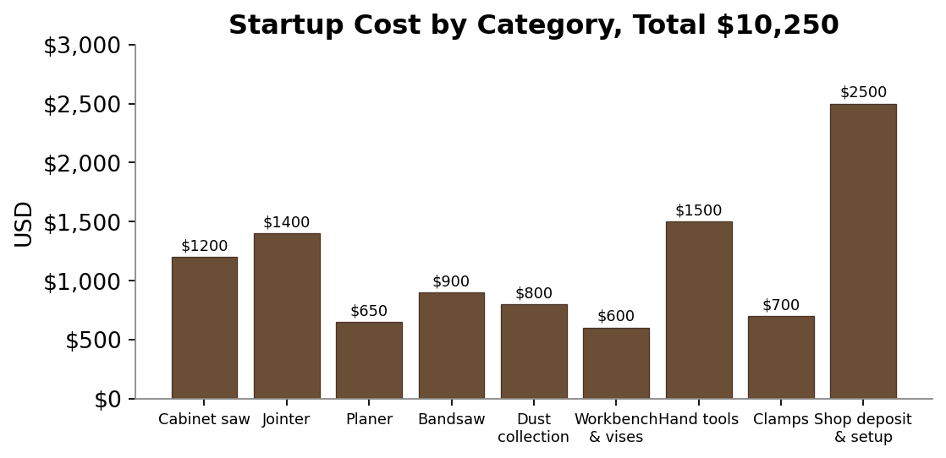
THE NUMBERS
Startup Costs
Item | Cost
Cabinet saw | $1,200
Jointer, 8 inch | $1,400
Planer, 13 inch | $650
Bandsaw | $900
Dust collection | $800
Workbench & vises | $600
Hand tools | $1,500
Clamps | $700
Shop deposit & setup | $2,500
Total startup | $10,250
Workshop business plan
Confidential

Slide 4
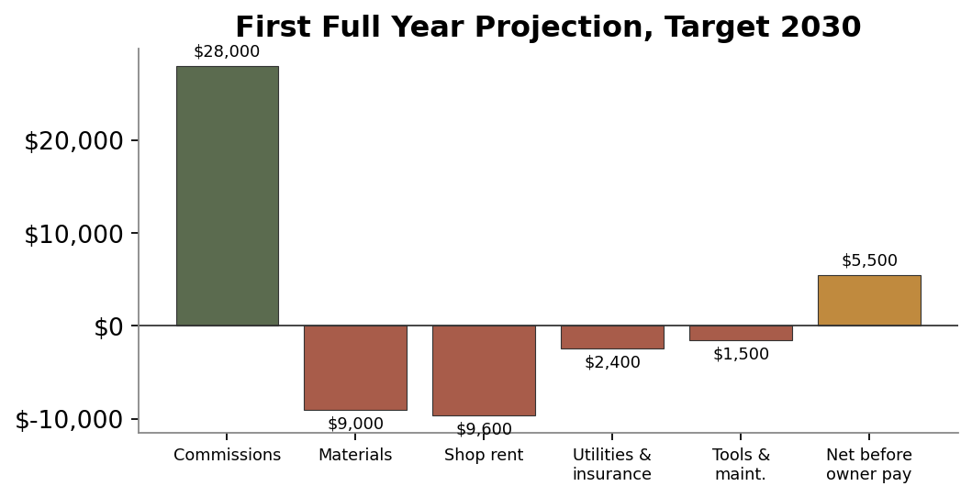
THE NUMBERS
First Full Year Projection, Target 2030
Line item | Amount
Projected commissions | $28,000
Materials cost | $9,000
Shop rent | $9,600
Utilities and insurance | $2,400
Tools and maintenance | $1,500
Net before owner pay | $5,500
A thin first year on purpose. The margin grows as the name does.
Workshop business plan
Confidential

Slide 5
THE PATH
Timeline and Risks
2027
2027 to 2029
2029
2030
Earn journeyman certification
Build experience and savings
Scout shop space, finalize tooling
Open the shop, first commissions
Main risks and how to manage them
Risk | Plan
Slow start on commissions | Keep day work, build a backlog before opening
Pricing my own time too low | Track hours per piece, set a shop rate early
Shop time vs day work | Phase in slowly, no quitting the day job too soon
Workshop business plan
Confidential

